Slide 1
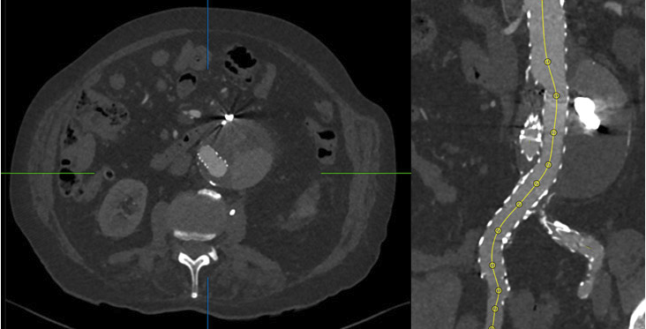

How to submit a clinical case for PVI:
Paris Vascular Insights Course
Clinical case
template
March 2026
Véronique Follet-Cougnon

Slide 2
General information
When a clinical case is submitted to PVI, it can logically be handled in several ways:
Submitted to be presented at the PVI Course
AND/OR
Submitted to be published on the PVI website
OR
Rejected, based on the reviewers’ assessment
By submitting your case, it is therefore your responsibility to let us know if any of these options do not interest you; otherwise, we will assume that we are free to use your presentation as we see fit.
Thank you for your understanding.

Slide 3
General information
By submitting my clinical case, I agree:
to come to Paris in December and present it at the PVI Course if I’m invited to do so
to make any requested modification so that it can be published on the PVI website
to respect the reviewers’ decision to reject my case if they decide so

Slide 4
Anatomy of the case
Part 1: case summary & clinical presentation of the patient –> How should I treat?
This first part can include any videos or images relevant to the description.
A poll with one or two questions to engage readers to vote on case management options must also be foreseen in case it is published on the PVI website, as part 1 is published first.
Part 2: final strategy decision and step-by-step planned procedure -> How did I treat?
The case author/s share their strategy and planning, the clinical evolution and the final outcomes, and once again include images, videos and/or other assessment tools to guide the reader through the case.
If relevant, Part 2 is usually published around a fortnight later on the PVI website.

Slide 5
Technical requirements
PowerPoint presentation including all the elements in a logical sequence
If publication on the website:
A poll to be added at the end of part 1 with:
1-4 questions
1-4 answer options
SwissTransfer can be used to send the related images and videos if too heavy
8 videos & 10 images maximum, all with a caption
Choose a catchy title, rather short, with no device name mentioned
Don’t forget to mention the theme and topic
to tag your case
(see the PVI list)

Slide 6
PVI Themes and related topics
AORTA
Occlusive disease
TBD / TAD
AAA
PERIPHERAL
Iliac / aorto iliac
Femoral bifurcation
SFA
BTK
AVF
VENOUS
CAROTID
MISCELLANEOUS
TAA
Cross device
Open surgery
Infection
Popliteal
Bypass
Traumatism
BTA
BTK
Desert foot
Bypass
Endo AVF
Surgical AVF
AVF complication
AVF infection
Superficial venous disease
Deep venous disease
Embolisation
CAS CES
Traumatism
Endovascular
Surgery
Traumatism
Infection
Other

Slide 7
Tips & tricks for the author
The case should ideally be structured in a narrative form for a publication in 3 sections:
Case presentation and (risk) assessment (part 1) + possibly the available treatment options
Treatment and outcome (part 2)
Take-home messages (we usually ask for 3 messages, to be added as conclusion in part 2)
It should raise questions to stimulate (online) discussion within the community.
Please provide a catchy, self-explanatory title (don’t mention any device name)
Please provide a short introduction : Please, keep the «suspense» and do not give away the answers about the final case management options, while providing some key words and being meaningful and attractive enough
Patient consent is the responsibility of the author/s
Don’t forget to provide us with the name of your institution and a picture of you + any possible conflicts of interest

Slide 8
Tips & tricks for the author
The case should include images and/or videos to support the content.
Please, provide all images and videos in the highest resolution possible (for heavy video files, you might need to use the SwissTransfer service).
Please, clearly indicate their title/caption and their position in the text
Please provide a maximum of 10 images and 6 – 8 videos (the videos should not exceed 10 seconds).
Images & videos should serve as illustrations of the case and may not resemble a product ad.
Don’t forget to suggest a poll that will be used in case your work is published on the website

Slide 9
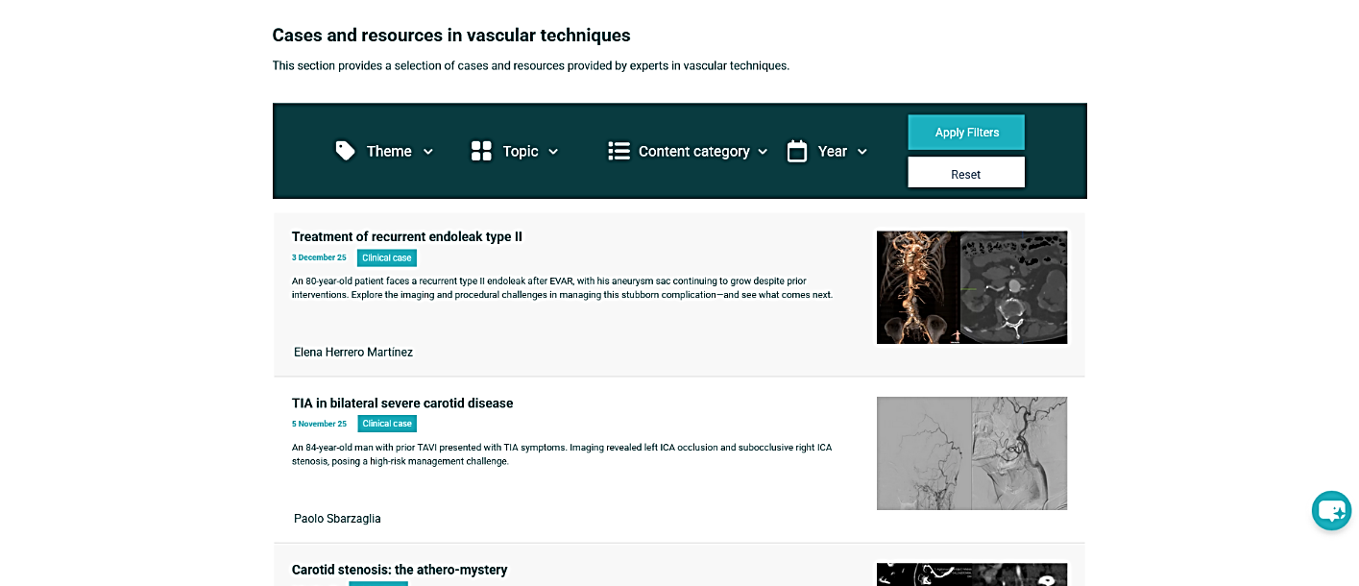
Some examples from the PVI website
The Cases and resources section of PVI hosts a selection of clinical cases provided by experts in vascular and endovascular techniques to share and discuss their experience with their peers.
Cases and resources in vascular techniques

Slide 10
Publication on the PVI website: workflow
The author submits her/his case through the PVI call for cases.
If the reviewers approve the case for publication on the website, the PVI editorial team informs the author by email and then creates the full case on the website.
Then, the editorial team makes it available as a link to the author/s and the PVI editor-in-chief to ensure that it has been interpreted correctly in its web format.
Once the case is approved for publication, Part 1 will be published and promoted (on social media, in the PVI bi-monthly newsletter, and on the PVI homepage)
Two weeks later, Part 2 is unveiled and promoted (and the poll results are revealed in the bi-monthly newsletter)

Slide 11
Thank you so much for your time. We look forward to start working with you!

